Slide 1
Multiplayer web games
A Guide on how to use socket io in conjunction with three js to create a multiplayer game.

Slide 2
Design
We will follow a client server model when designing our networking
This means if client a wants to communicate with client be they must send a message to the server who will relay that message to the appropriate client
We will use a client authoritative model, trust the client.

Slide 3
Library
We will be using socket io to do our networking. Socket io is a library which makes working with websockets super easy and convenient.

Slide 4
What is a socket
A socket is a communication protocol allowing for a persistent two-way connection between devices facilitating real time data transfer.

Slide 5
80 / 20 rule
The 80 / 20 rule states that 80% of outcomes come from 20% of causes.
In the case of socket io there is just a few functions (20%) that are used very commonly across the project (80%). So if you can know these few functions you will have enough knowledge to create a multiplayer game.
So what are these functions?

Slide 6
Client Functions

Slide 7
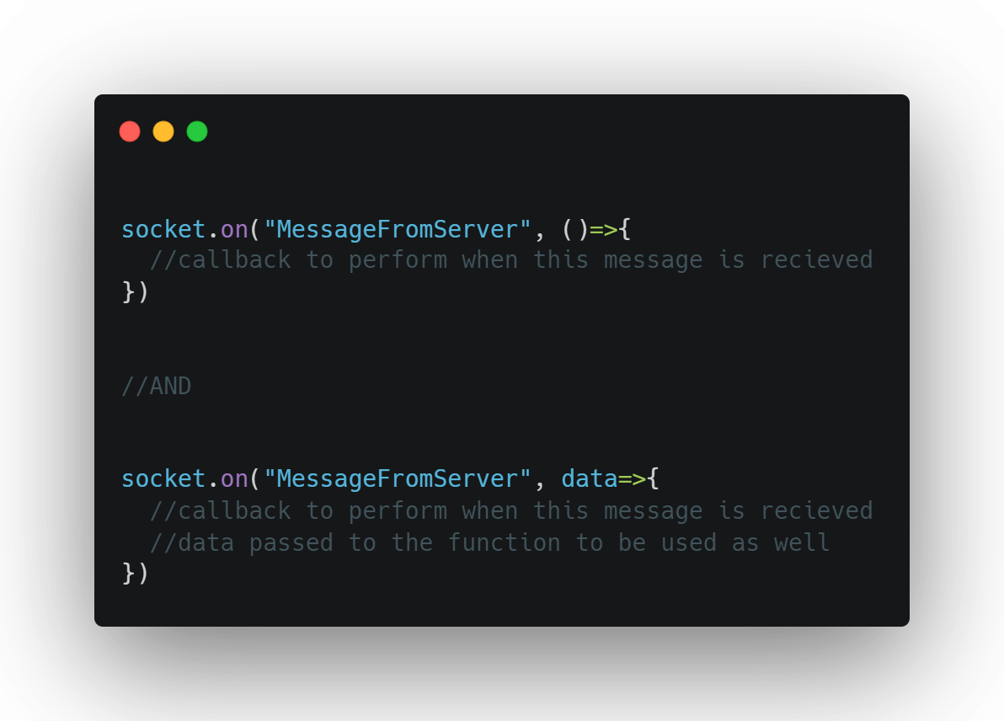
Assume socket here is an object accessible from this scope
This is how to react to messages from the server

Slide 8
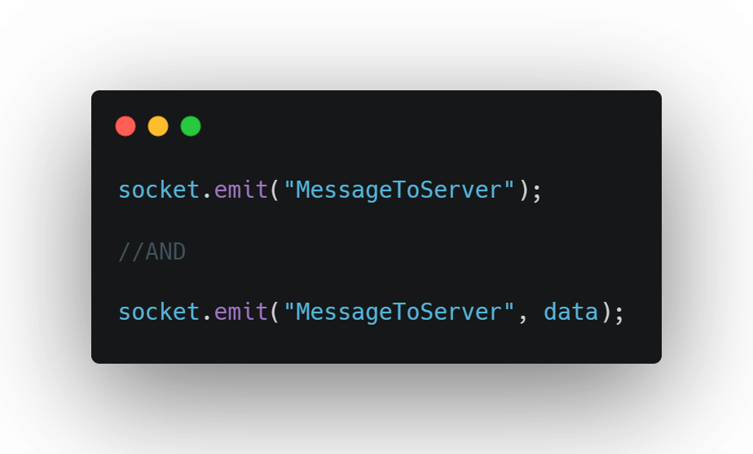
Assume socket here is an object accessible from this scope
This is how to send messages to the server

Slide 9
THAT’S IT!
For your client’s code at least

Slide 10
Server Side Functions

Slide 11
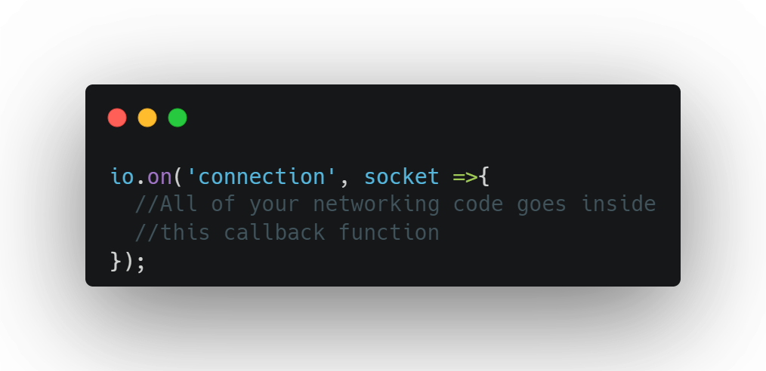
Assume io here is an object accessible from this scope
Notes:
What this does is assigns an event listener to react to a socket connecting to the server.
This callback will be ran for each socket when they connect to the server. Each socket represents a two way communication between server and client

Slide 12
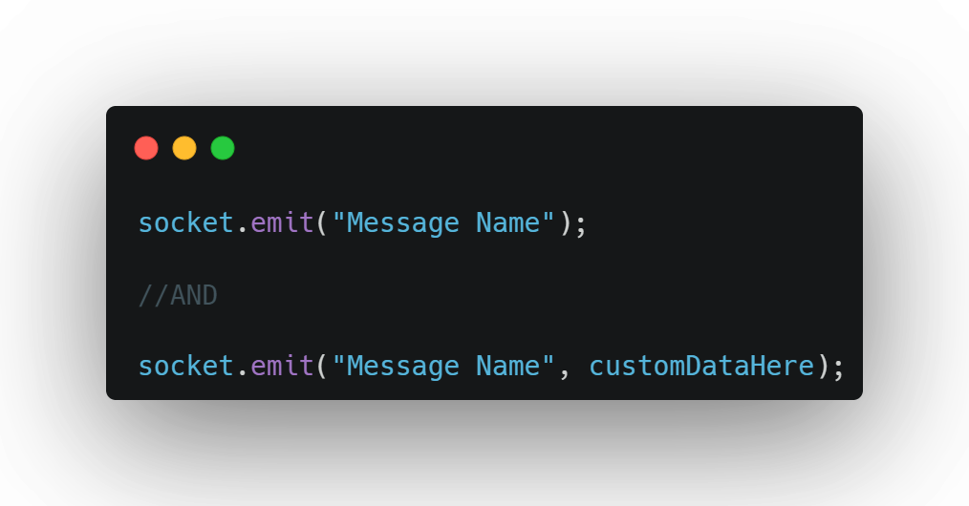
Assume socket here is an object accessible from this scope

Slide 13
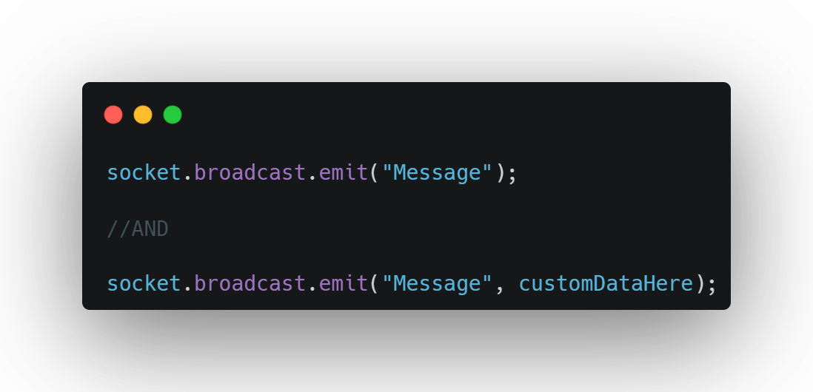
Assume socket here is an object accessible from this scope

Slide 14
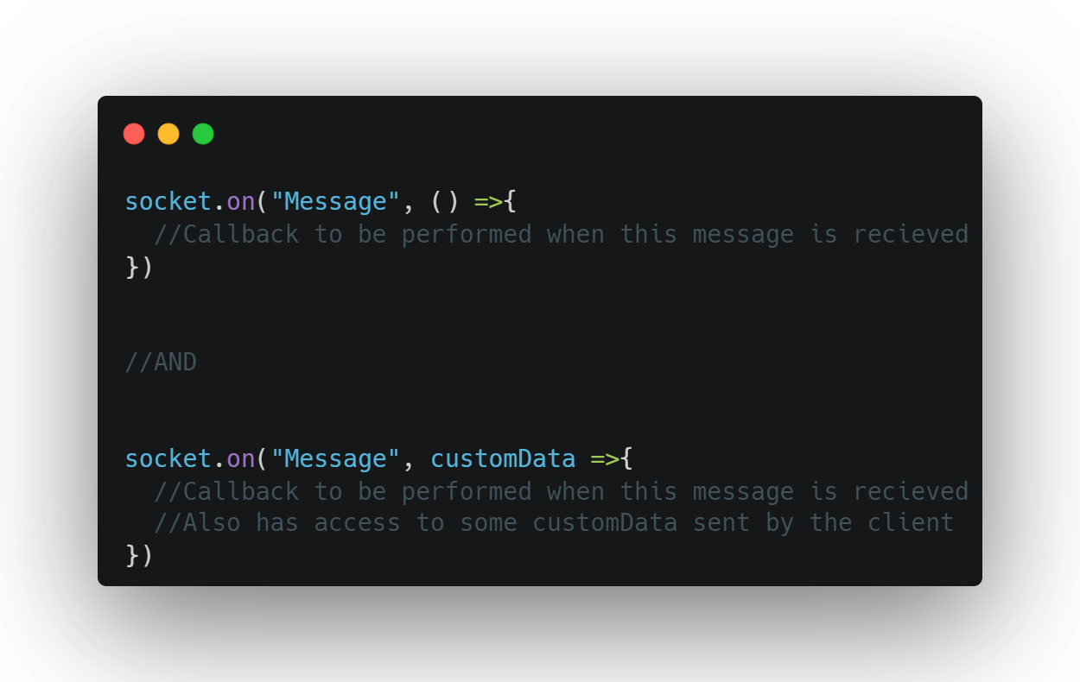
Assume socket here is an object accessible from this scope

Slide 15
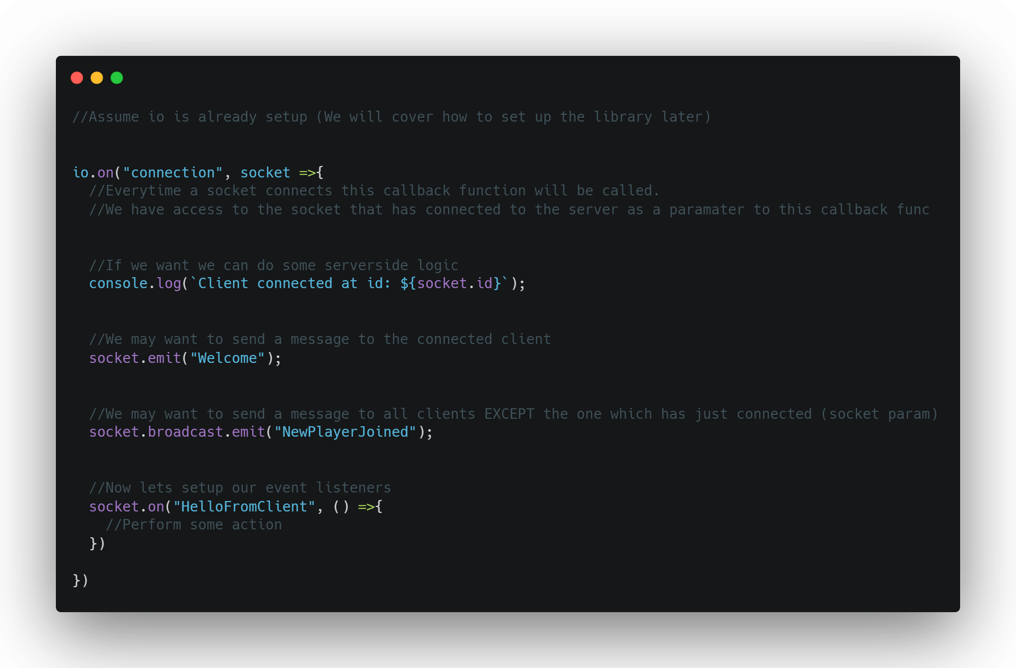
All Together

Slide 16
Quick recommendation before we start
I used Jetbrains Rider as my ide for this
And it was leagues above any other ide’s that ive used so far.
It actually has IntelliSense you can be confident in and also has IntelliSense for all the THREEjs symbols which was very useful.
Its recently became free via a community licence but is also available to students
So yeah… get rider its great!

Slide 17
Demo Scene

Slide 18
How it's made part 1 setting up the scene

